Slide 1


“Swachh Bharat: Monitoring the garbage collections from Gram Panchayat”
GST - Bengaluru Campus
Department of Computer Science and Engineering
Project Phase-II (Review-2)Presentation
Under the guidance of
Mr.Mohan Gowda V
Asst.Prof
Presented by
Saikiran Mekavaru (322010337002)
Ganugapenta Sravan (322010337029)
Shaik Iliyas (322010337026)
S Shivakrishna reddy (322010337054)

Slide 2

Outlines
Abstract
Introduction
Literature Survey
Overall Architecture
DFD (level-0)
DFD (level-1)
UML Diagram
List of Modules
Implementations (Screenshots)
Conclusion and Future Enhancement
References

Slide 3

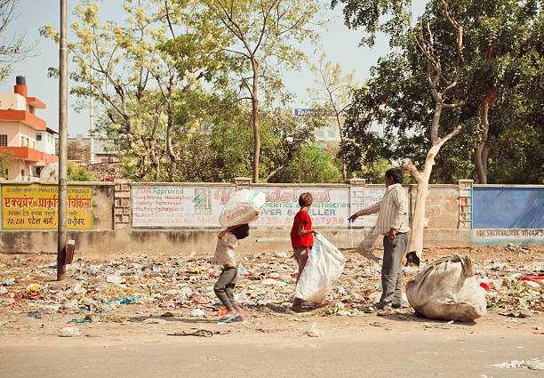
Abstract
Our project is dedicated to revolutionizing waste management in residential areas through the implementation of a Web-based system. we aim to streamline the waste collection process, reduce environmental impact, and promote sustainability.
Images: from Google

Slide 4
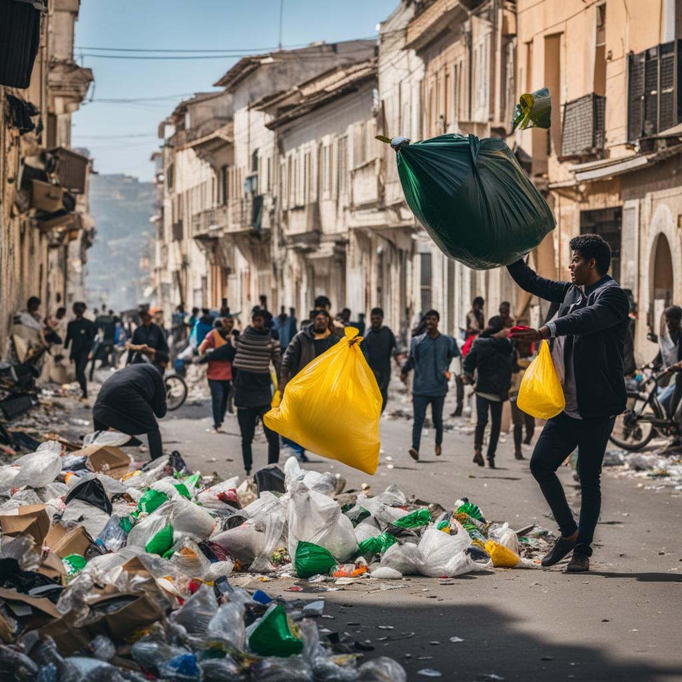
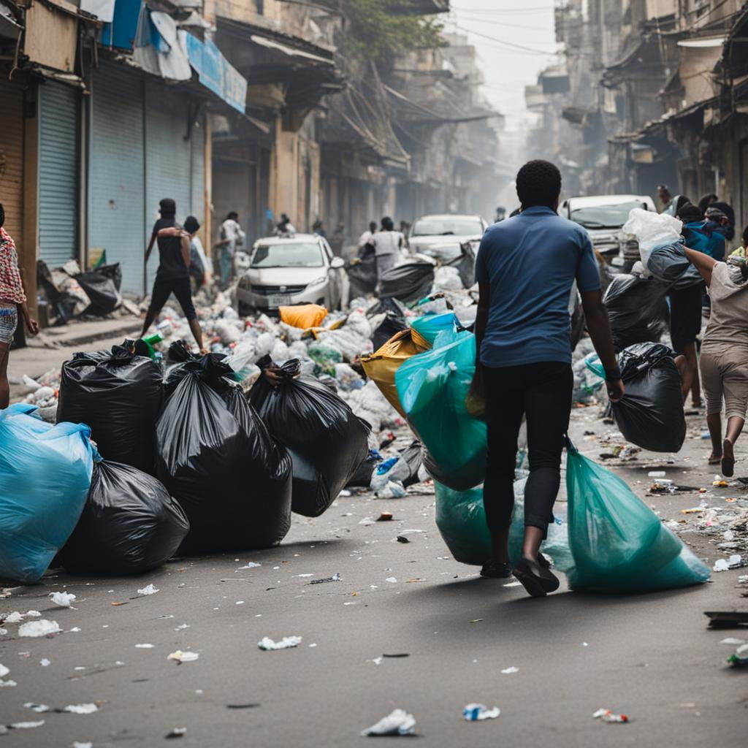
Introduction
India faces inefficient waste management practices, leading to pollution and health risks.
The problem addressed by the “Swachh Bharat: Monitoring the garbage collections from Gram Panchayath”.
Images by Craiyon image generator

Slide 5
Research Objectives
Registration Portal
Admin Portal
Status Updation
Report

Slide 6
Literature Survey
Title, Author and Date | Summary of Paper | Draw backs
Title: Learned Garbage Collection Authors: Ryan Marcus12, Hongzi Mao, Justin Gottschlich2,Mohammad Alizadeh1,Tim Kraska1 Year: 28 April 2022 | Used programming languages use garbage collectors(GCs).Such collectors must decide when to look for unreachable objects to free, which can have a large performance impaction some applications. In this preliminary work, we proposed design for a learned garbage collector that autonomously learns over time when to perform collections. By using reinforcement learning, our design can incorporate user-defined reward functions, allowing an autonomous garbage collector to learn to optimize the exact metric the user desires | Garbage collectors bring some runtime overhead that is out of the programmer's control. This could lead to performance problems for large applications that scale large numbers of threads or processors, or sockets that consume a large amount of memory
Title: Garbage Collection Robot and Monitoring System Using Wireless Communication Authors: K. Vasanth, K S Srinivasan Year: March 2021 | The proposed a framework that has effectively been executed. Through our proposed framework we also aim to significantly reduce costs and thereby we provide open entryways for versatile creation of self-sufficient cleaning robots in the market. In future our robot can be improved in such a way that it can differentiates between static and dynamic objects. | Overhead that is out of the programmer's control. This could lead to performance problems for large applications that involves High amount of power and cost.
Title: Website Designing Using Html, Css, JavaScript & Wordpress Authors: Mr. C. Mohan Sir,K Jaya Chitra Mam,Himanshu Shekher Year:03/March-2022 | This paper is to create a Self-Designed Website using HTML, CSS, and JS, which is not only Unique, but it is highly Optimized also, and make sure that this Website is used for Online Business such as Shopping, Blogging, Digital- Marketing, etc. | Websites involve Blogging, Marketing,Advertising, etc. Our development process enables security issues the rendering of Web pages in a very fast and optimized way by ensuring the good user experience on mobile, tablet and desktop devices

Slide 7
Literature Survey
Title, Author and Date | Summary of Paper | Drawbacks
Title: An Introduction to WebTechnology Authors: Sumit Tiwari Year: December 2016 | Web technology, its benefits, application areas, and its impact on marketing, advertising, secure payment systems, education industries, etc. and technological world. Initially,developed and use for inventory tracking stuff | Need code users must have a reader app, which limits the audience; Security issues, before scanning a code, the scanner can never really know where the code is going to lead them; Lack of public awareness, large portion of population is still unaware of this technology
Title: IoT based smart garbage collector for smart cities Authors: Asha Natha Year: December 2022 | The explained model proposes an efficient, cost effective waste management model with a minimal investment implementing the latest technologies. Manual interference is reduced to the extent. Here everything is automated and the data is available online. | Cost: Smart bins are generally more expensive to manufacture, install, and maintain compared to traditional waste bins. Maintenance Complexity: The technology integrated into smart bins can introduce complexity
Title: Web based-application Authors: P. Sutheebanjard Year: November 2019 | In this paper, we show how to create via the web browser that facilitates users to easily create their own codes for websites, emails, business cards, print ads and so on. The proposed method was developed using entirely open source software such as code Ubuntu. | It require a Desktop Smartphone with the ability to scan the code. Requires internet connection. QR codes also require an internet connection in order to function. Distrust and unfamiliarity. For many people even now, QR codes are fairly new technology. One-way communication.
Title: Online Survey: A Case Study of Google Forms Authors: NarayanaswamyVasantha Raju N.1and N.S.Harinarayana in Year: 2021, January | The Google Forms is a cloud-based data management tool used for designing and developing web-based questionnaires. The survey link was disseminated trough email and trough the schools board. We have over 1200 responses in a spreadsheet, which are being organised &specialized in such data analysis. | We need to fill Google form again and again instead of that we are using Prefilled Google form to every record to save time.

Slide 8
Literature Survey
Title, Author and Date | Summary of Paper | Drawbacks
Title: Website material flow monitoring in a subcontractor manufacturer network Authors: Jakko Peltokorpi, Lauri Isojärvi, Kai Häkkinen, Esko Niemi Year: 18 June 2021 | This paper proposes a order monitoring system in a subcontractor manufacturer network. A prototype system was built and demonstrated to feasibility study showed that the monitoring system is practical and promising. The companies, however, recognize that its implementation would be challenging from both the technical integration and subcontractor adaptation points of view. | It require a Smartphone with the ability to scan the code. Requires internet connection. also require an internet connection in order to function. Distrust and unfamiliarity. For many people even now, are fairly new technology. One-way communication
Title: Developing a dynamic website using the online website builder Weebly for Viking Fortune Oy Authors: Md. Shamsul Arafin,Yi Jiang Year:December, 2021 | The primary objective of this project is creating a new dynamic website for Viking Fortune oy to increase the product visibility to the potential customer. Additionally, another objective of this project is to create the website by using an online website builder which can be updated regularly by employees of Viking Fortune | QR codes require a smartphone with the ability to scan the code. Requires internet connection. QR codes also require an internet connection in order to function. Distrust and unfamiliarity. For many people even now, QR codes are fairly new technology. One-way communication
Title: Website Designing Using Html, Css, JavaScript & Wordpress Authors: Mr. C. Mohan Sir,K Jaya Chitra Mam,Himanshu Shekher Year:03/March-2022 | This paper is to create a Self-Designed Website using HTML, CSS, and JS, which is not only Unique, but it is highly Optimized also, and make sure that this Website is used for Online Business such as Shopping, Blogging, Digital- Marketing, etc. | After finishing this project, authors will be more experience in web development by learning a new web developing platform, gain more knowledge about using the website as a marketing tool, improving communication skills by understanding the requirements of a business client.
 |  | .

Slide 9
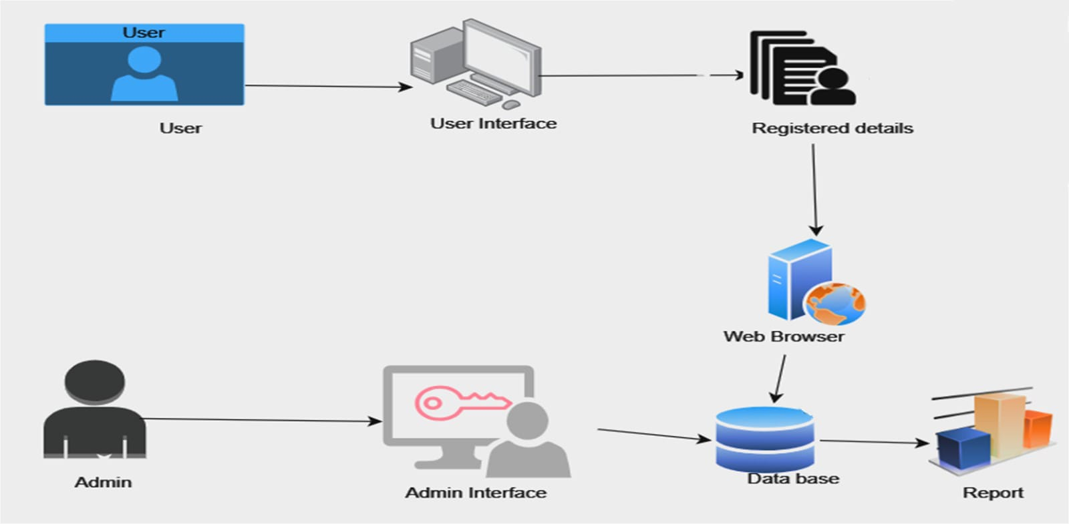
Overall Architecture

Slide 10
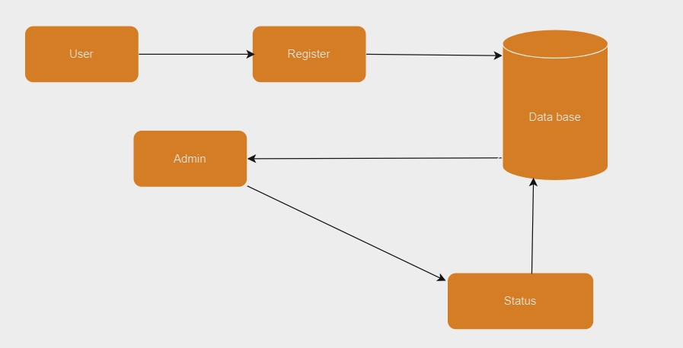
Data Flow Diagram

Slide 11
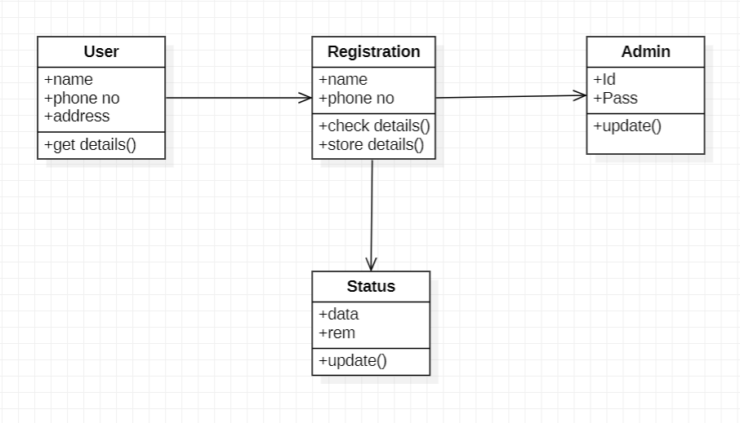
UML Diagrams (Class Diagram)

Slide 12
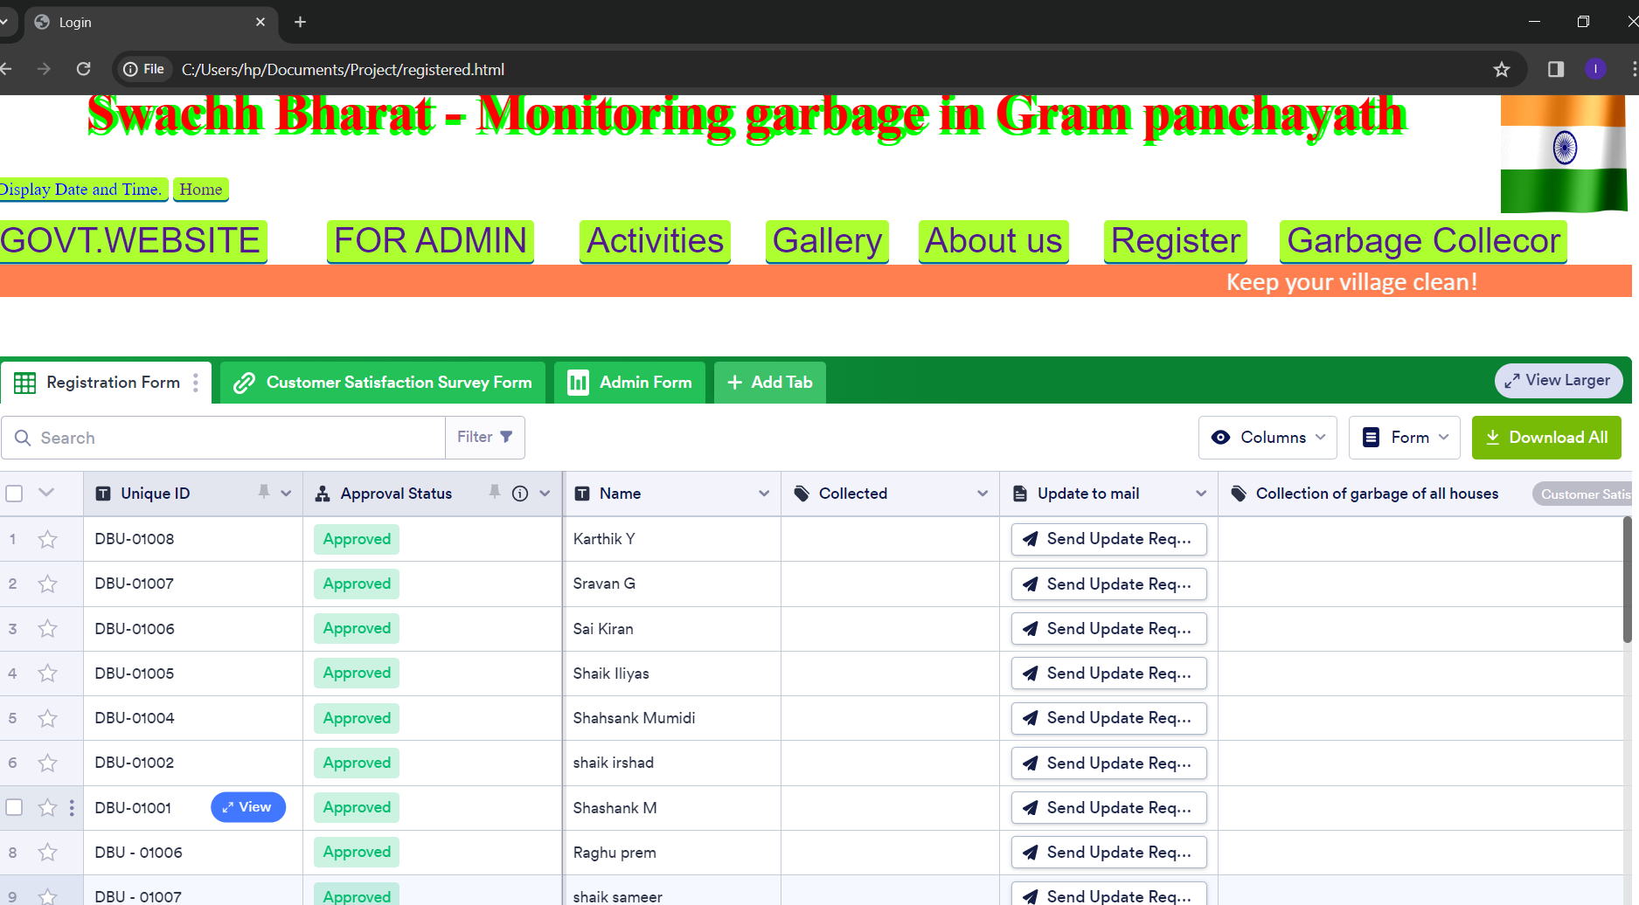
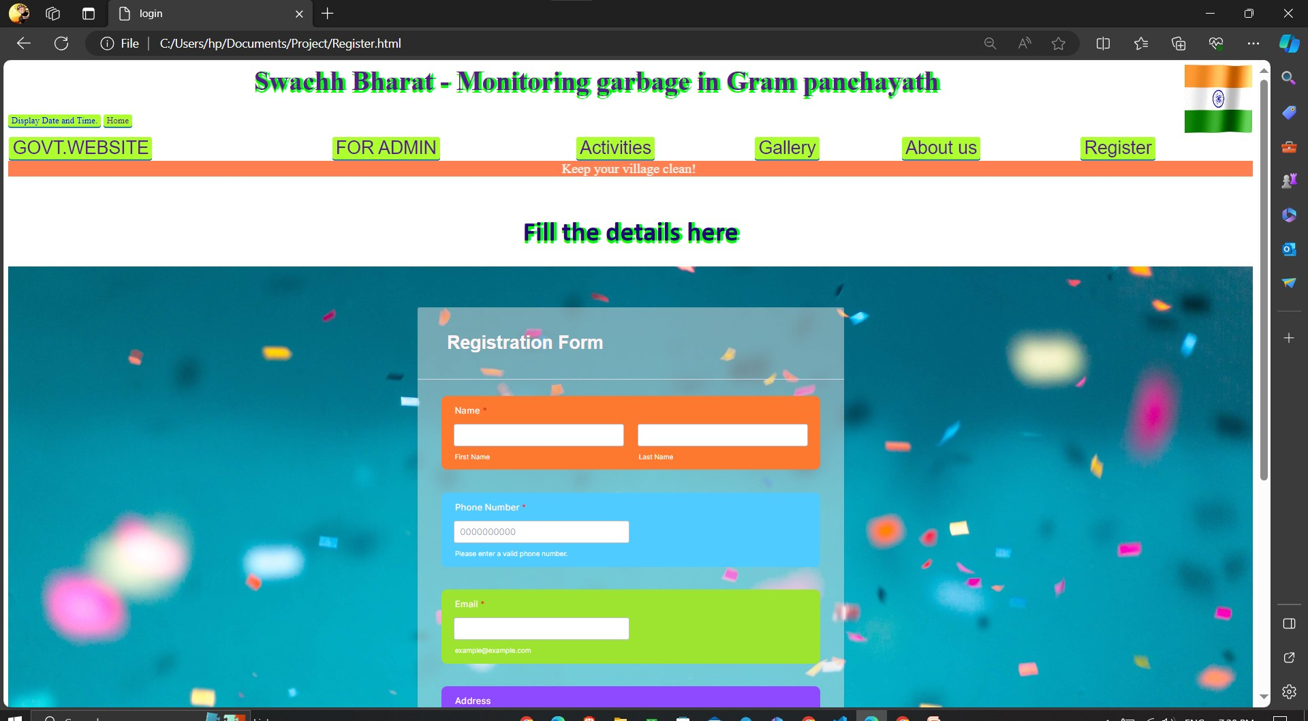
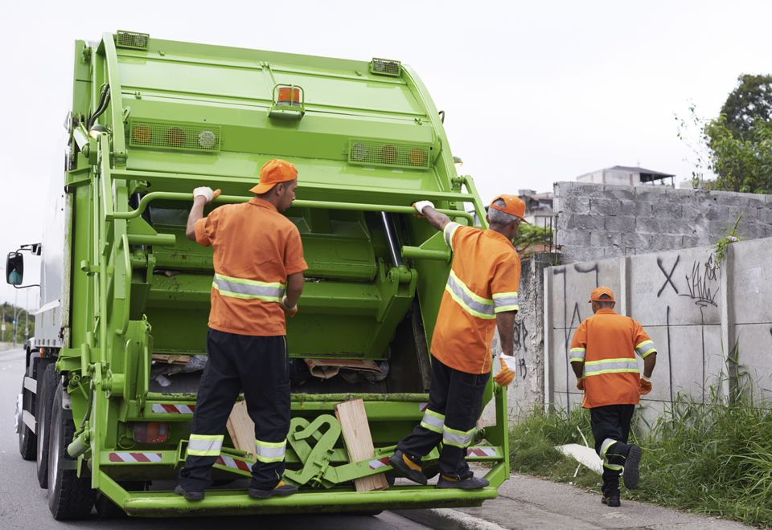

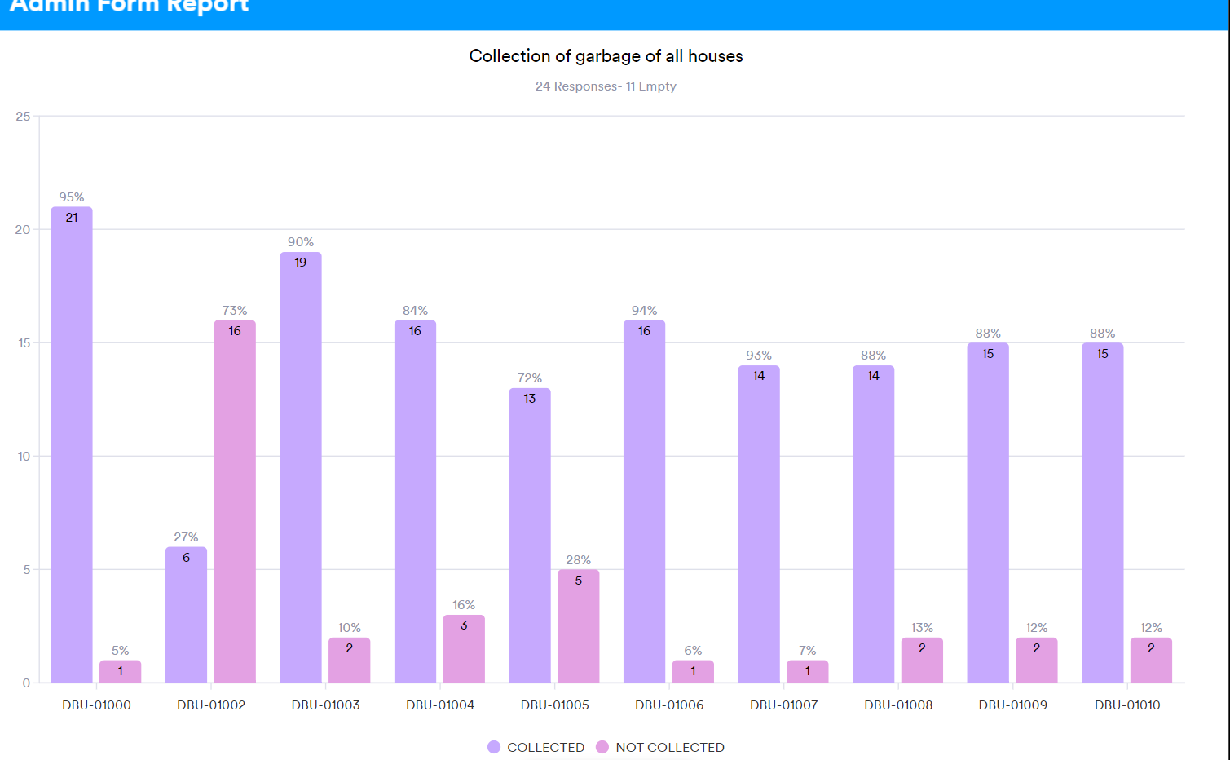

List of Modules
User Interface
Registration Form
Garbage collector Form
Admin Database
Report

Slide 13
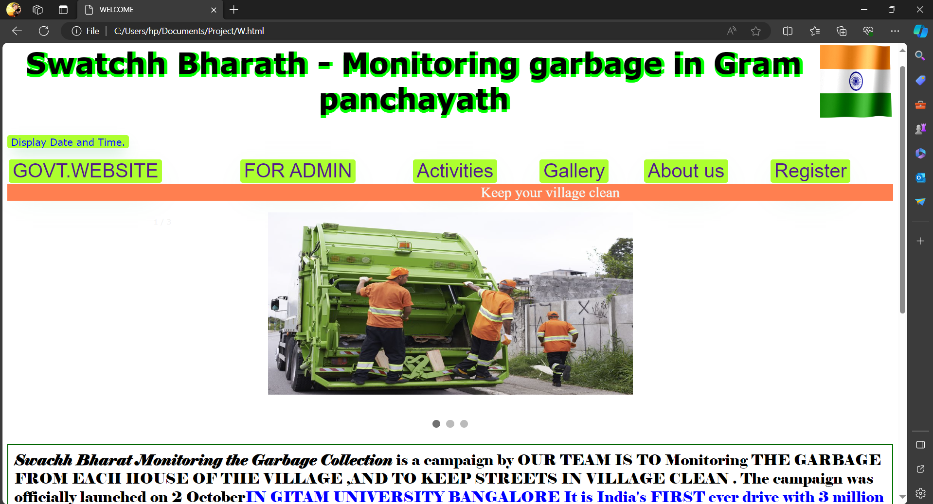
Implementation

Slide 14
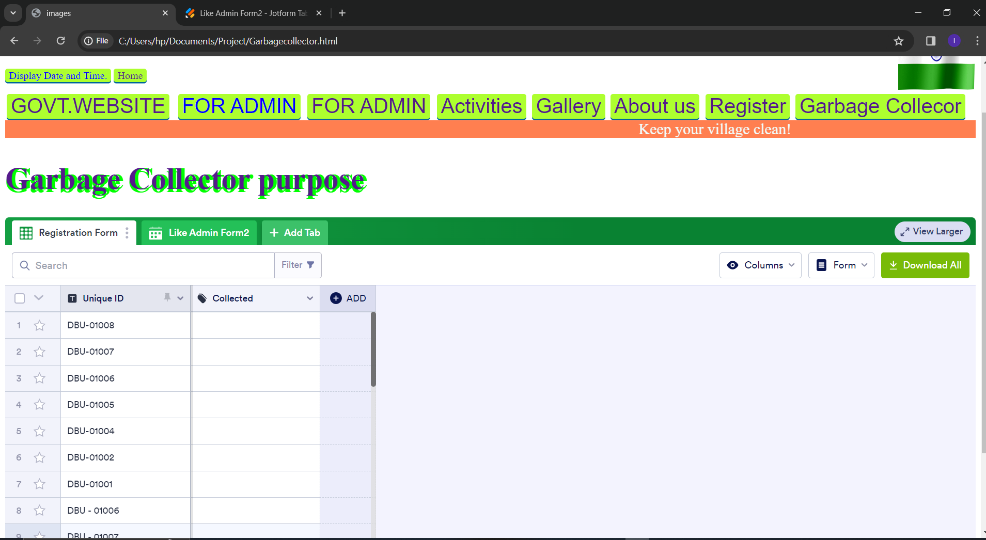
Implementation
Registration Form
Garbage collector Form

Slide 15
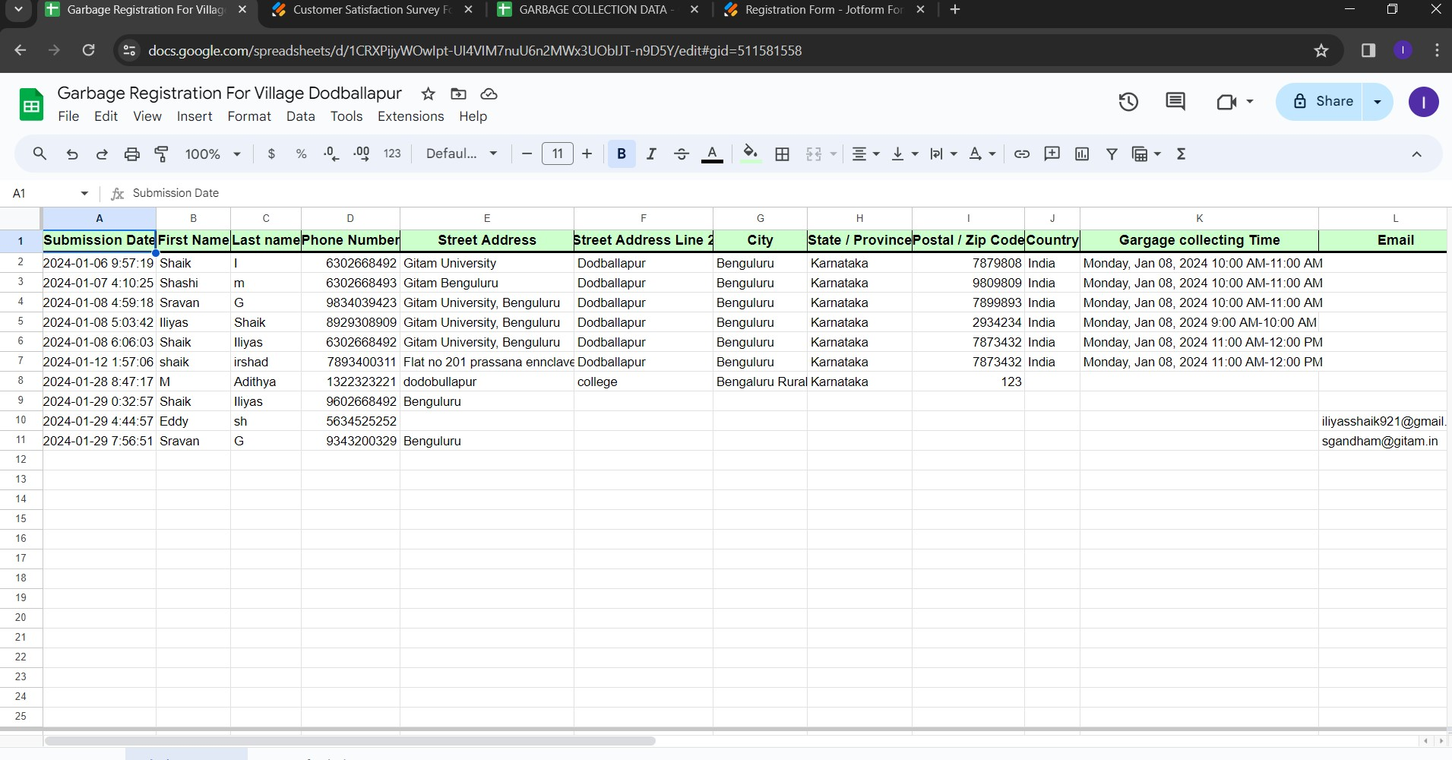
Implementation
Registration database
Admin Database

Slide 16
Implementation
Final Report

Slide 17
Conclusion
By using web technology we are monitoring the garbage status of each and every user and generating report , it implies that a contribution to greenery and healthy environment.

Slide 18
References
[1] Sumit Tiwari, Sandeep Sahu, “A Novel Approach for the Detection of
OMR Sheet Tampering Using Encrypted Web Based”, IEEE -
International Conference on Computational Intelligence And Computing
Research (2014), Coimbatore – India, 2014, pp. 604-608.
[2] Nallapaneni Manoj Kumar, Sonali Goel and Pradeep Kumar Mallick,"Smart Cities in India: Features, Policies, Current Status, and Challenges", IEEE International Conference on Technologies for Smart-City Energy Security and Power (ICSESP-2018), March 28-30,2018.
[3] Yuan-Cheng Lai, Frannie Han, Yi-Hsuan Yeh, Ching-Neng Lai and
Yu-Chin Szu, “A GPS navigation system with Report and
friend positioning in smart phones,” 2 nd International Conference on
Education Technology and Computer (ICETC), pp.V5-66-V5-70, 22-
24 June 2010

